Slide 1


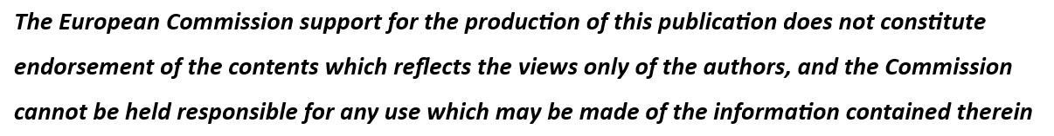
Industrial Symbiosis Workshop
Blått Kompetansesenter (Blue Competence Center)
23-24.05.2022
WP 10.2 Industry Microforums
Event landing page:
https://bksnorge.no/portfolio/industriell-symbiose/

Slide 2
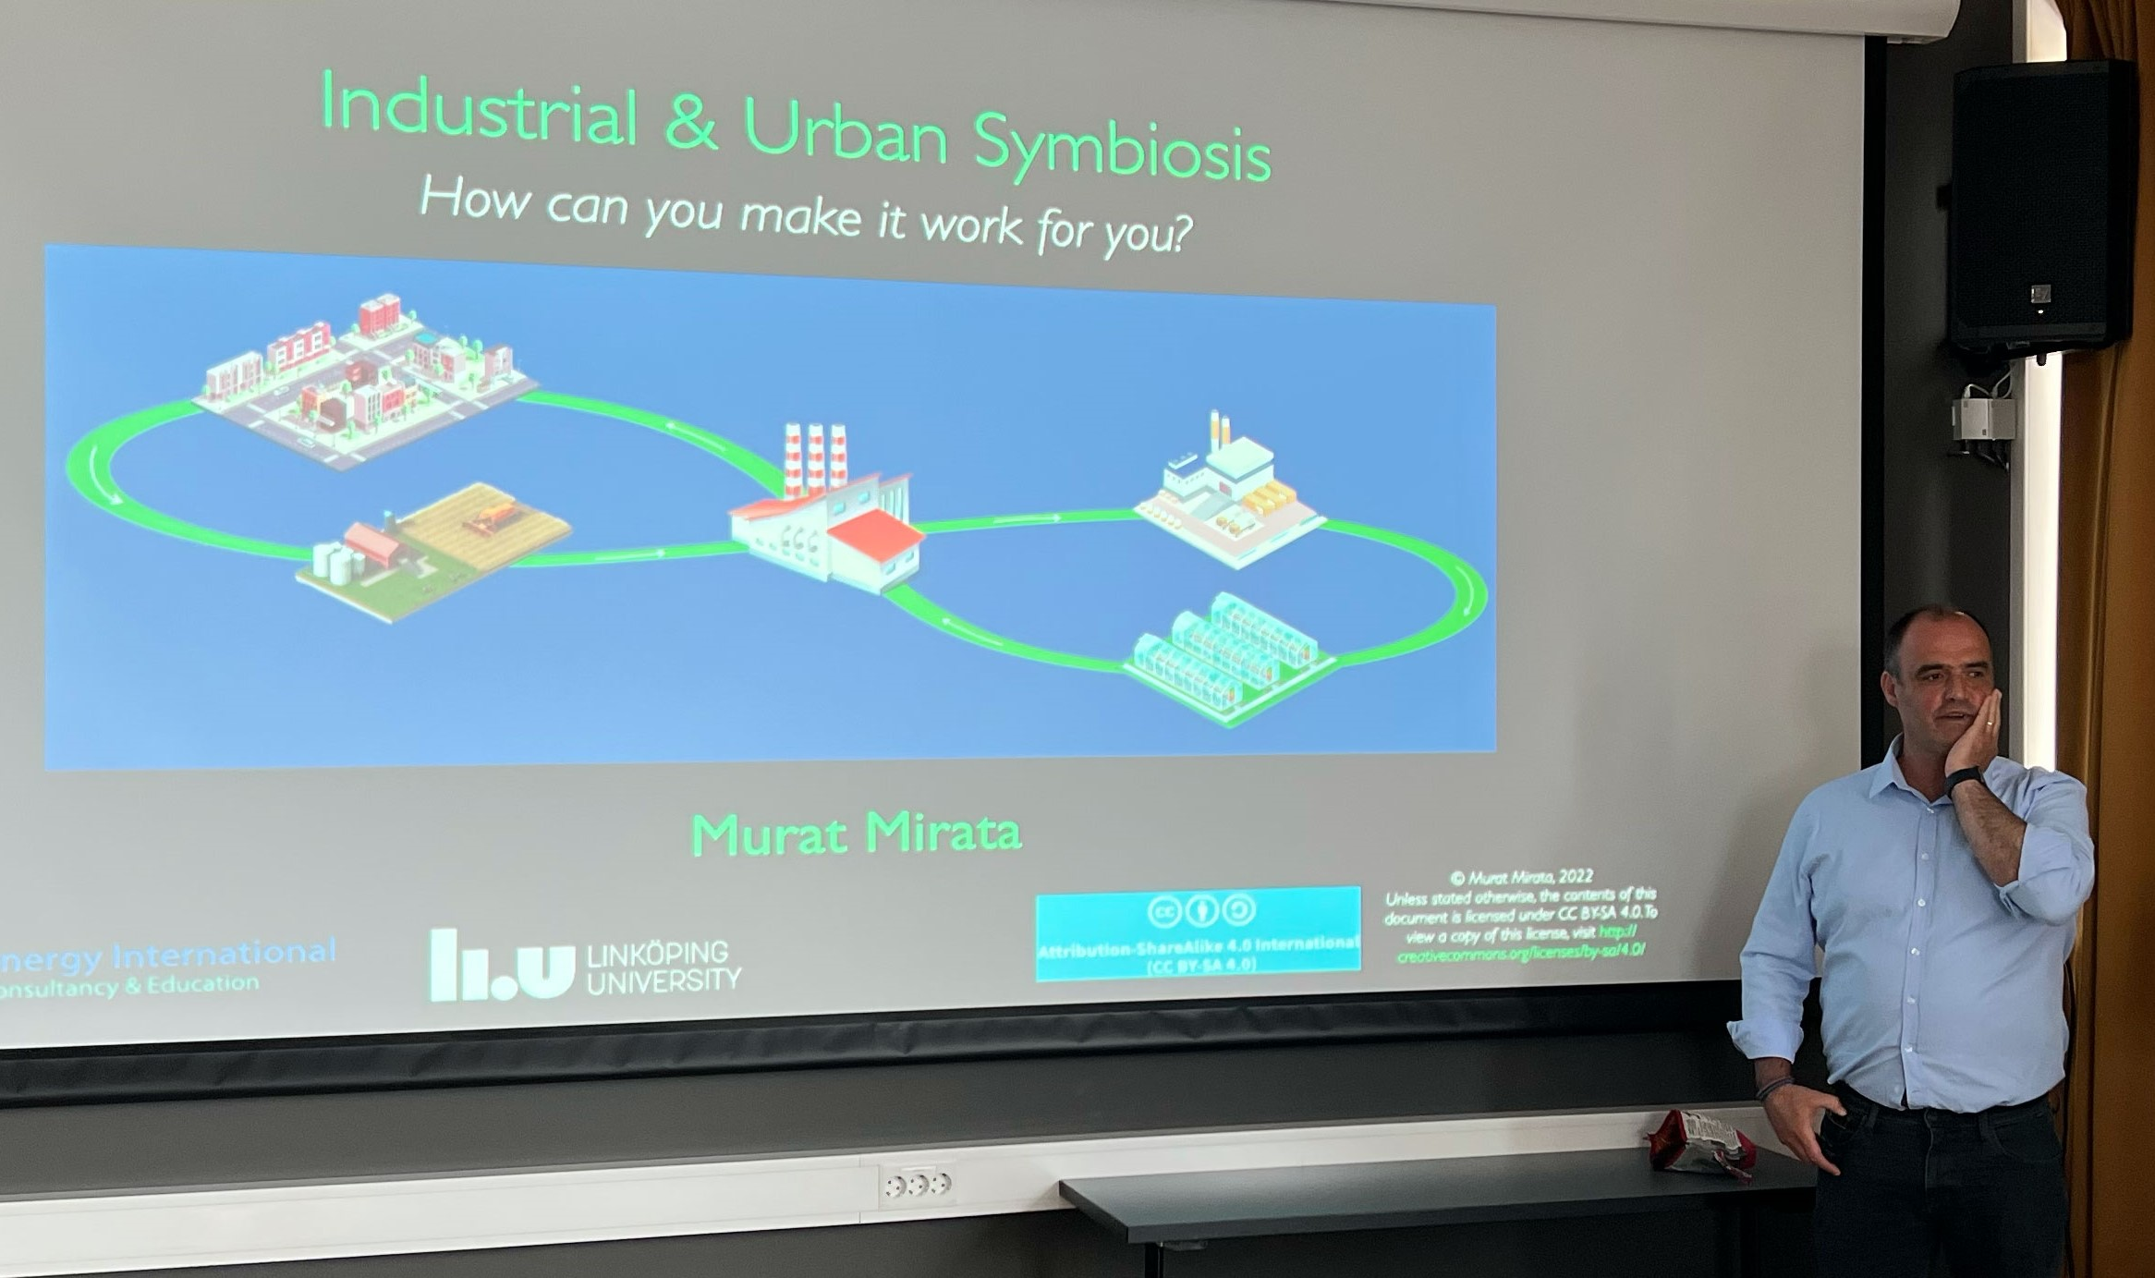
Workshop content
The workshop is open to those who are a decision-maker or manager responsible for spatial planning, development, remodeling and maintenance of buildings and facilities at their workplace.
Course participants get:
Updated and research-based knowledge of climate-friendly spatial and resource planning
A meeting place to discuss and ask for advice
Get to know local and international examples of industrial symbiosis in practice - learn from the experiences of others
Opportunity to influence how the Business Gardens in Norway work together to gain more knowledge locally and nationally
Industrial Symbiosis Workshop at Hitra, led by Murat Mirata from Linköping University

Slide 3
Why is Industrial Symbiosis useful for SMEs and larger enterprises?
Industrial symbiosis is about connecting companies from different industries. Resources such as materials, raw materials, energy, water etc. must be able to be used several times. When arrangements are made for a company to utilize surplus or waste resources from neighboring companies in its production, this is industrial symbiosis. In this way we achieve a significantly more efficient use of resources, and we get increased employment in companies within a circular economy.
Industrial Symbiosis Workshop at Hitra, led by Murat Mirata from Linköping University

Slide 4
Organiser
Business Garden Frøya and Hitra, Sølvi Nordin
Blått Kompetansesenter (Blue Competence Center)
Presenters
Murat Mirata, Professor at Linköping University
Per Erik Sørås, Consultant at Trøndelag County
Ole Joar Flaat, CEO Skogmo Industry Park
Joaquin Ignacio Quezada Ortega, environmental engineer at CRUM
Industrial Symbiosis Workshop at Hitra, led by Murat Mirata from Linköping University

Slide 5
Workshop guideline
Blått Kompetansesenter (Blue Competence Center) manages the Business Garden of Hitra and Frøya with the express purpose of giving local businesses help in skills building and international scaling. To this end, the Norwegian national network SIVA funds the business gardens for these activities.
BKS identified industry needs through workshops and meetings in their business garden network, amongst which is a better understanding of industrial sustainable measures
Industrial Symbiosis chosen as workshop goal to promote sustainable skills locally
BKS contacted relevant Industrial Symbiosis experts and those with experience in it to present and hold the workshop
BKS organized a 2-day workshop, from lunch to lunch
Workshop fee for participants (lunches included in the price)
Landing page created for the event on the BKS-website including a sign-up link (using eMarketeer)
Direct sales in the form of newsletters and phone calls to the business garden network
Marketing campaign in local papers and digitally to inform the relevant general public (local businesses)
Industrial Symbiosis Workshop at Hitra, led by Murat Mirata from Linköping University

